Slide 2
Overview
Pengenalan pemrograman
Pengenalan Javascript
Pengenalan HTML
Install tools (VSCode & live-server extension)
Day 1: Tipe data, Syntax, Operator, Comment, Event
Day 2: Functions, Conditions, Comparison, HTML Input
Goal
Membuat aplikasi web sederhana yang nanti nya akan dipresentasikan bersama

Slide 3


Fadly Kayo (Fadly) fadly@g2academy.co
Perkenalan
Latar belakang
Metode mengajar
Motivasi belajar programming

Slide 4
Rules to Learn to Code
Trick Your Brain with the 20min Rule
If you tell yourself that you are just going to do 20 minutes of coding practice, you will most likely succeed and use your own inertia to end up learning for an hour or more. No brain will perceive a 20-minute task as a lot of effort and you end up tricking your brain to take advantage of your evening.
Develop a Habit
Research suggests that in order to develop a new habit, you have to carry out the task daily for a month
Code for a Purpose
If you are learning to code for the sake of learning to code, it’ll be pretty difficult for you to get good at it. Start learning to code by following a tutorial that makes you end up with making something, creating something.
There is No Perfect Language to Learn
There will always be one person who asks “which programming language should I start learning first”? There is this common perception that somewhere out there lies a perfect language for beginner programmers. A programming language is simply a tool. It is no different from any other tool in your hardware box.
It’s Ok to Not Know
Keep Learning
Sources: www.appbrewery.co

Slide 5
Pengenalan Programming
What is programming?
Programming is a way to instruct the computer to perform various tasks
Instruct the computer: basically means that you provide the computer a set of instructions that are written in a language that the computer can understand
Examples: Adding 2 numbers, rounding off a number, or complex ones which may involve a sequence of multiple instructions. For example: calculating the average return on a stock over the last 5 years
Just like we humans can understand a few languages (English, Spanish, Mandarin, French, etc.), so is the case with computers. Computers understand instructions that are written in a specific syntactical form called a programming language

Slide 6
Pengenalan Programming
Why you should learn programming?
Programming is fun: create own games, personal blog, e-commerce, etc
Pretty good salary: top programmers in the Silicon Valley make millions of dollars every year. Quite a few companies offer starting salaries as high as $100,000 per year
The backbone of a Technology Company: knowing programming can help you create the next big tech company (Google, Facebook, Microsoft, Apple, Amazon)
Computers are fast
Computers can work 24x7
Sources: https://hackr.io/blog/what-is-programming
Video: https://www.youtube.com/watch?v=FCMxA3m_Imc

Slide 7
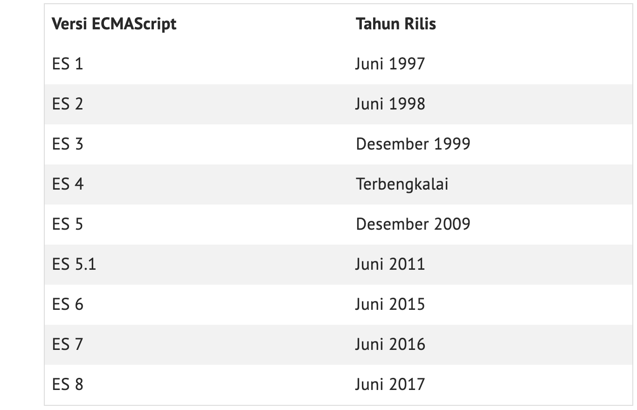
Pengenalan Javascript
What is Javascript?
JavaScript is a computer programming language that executes complex actions on web pages
Introduced by Netscape under the name LiveScript, but renamed into JavaScript in 1995
In November 1996, Netscape submitted JavaScript to ECMA International to carve out a standard specification, which will be known later on as ECMAScript (standardized JS)

Slide 8
Pengenalan Javascript
Why Javascript?
JavaScript was initially created to make web pages alive
No matter if you’re on your phone, on a laptop, or an old PC at the public library, any time you click a button, see social posts update in real-time, you will learn JavaScript is most likely involved in making that happen
JavaScript is one of the languages all web developers must learn
Core technologies of web applications: HTML CSS JS
Initially only implemented client-side in web browsers, JavaScript engines are now embedded in many other types of host software, including server-side in web servers and databases, and in non-web programs such as word processors and PDF software, writing mobile and desktop applications, including desktop widgets
Sources:
https://javascript.info/intro
https://www.petanikode.com/javascript-dasar/

Slide 9
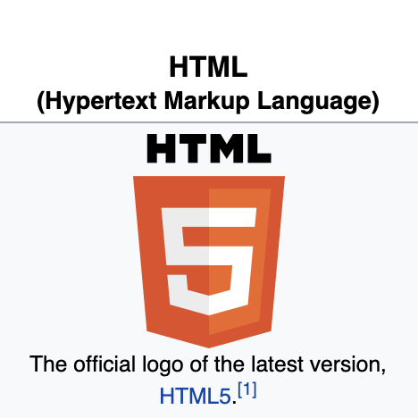
Pengenalan HTML
What is HTML?
Hypertext Markup Language (HTML) is the standard markup language for documents designed to be displayed in a web browser. It can be assisted by technologies such as Cascading Style Sheets (CSS) and scripting languages such as JavaScript
With HTML you can create your own Website
Sources:
https://en.wikipedia.org/wiki/HTML

Slide 10
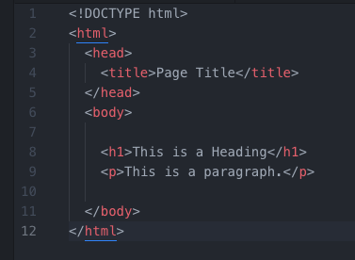
Pengenalan HTML
The <!DOCTYPE html> declaration defines this document to be HTML5
The <html> element is the root element of an HTML page
The <head> element contains meta information about the document
The <title> element specifies a title for the document
The <body> element contains the visible page content
The <h1> element defines a large heading
The <p> element defines a paragraph
Sources:
https://www.w3schools.com/html/

Slide 11
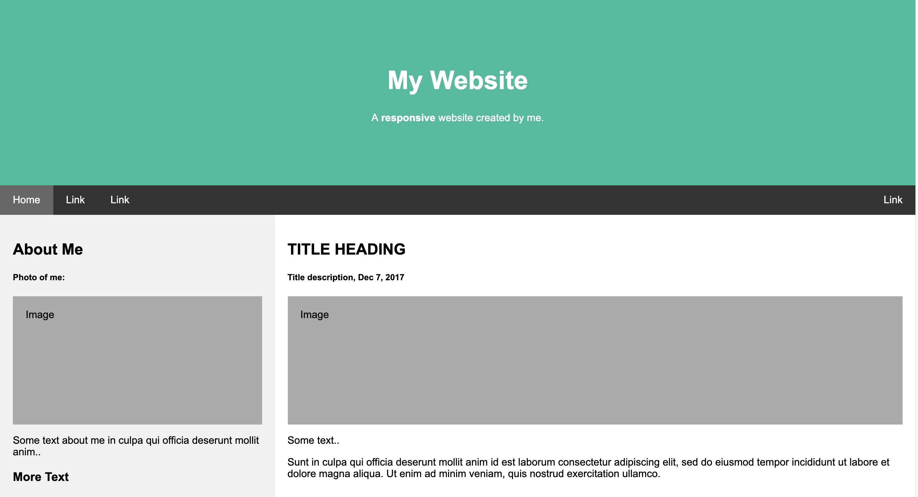
Pengenalan HTML
Sources:
https://www.w3schools.com/html/html_intro.asp
https://www.w3schools.com/html/html_examples.asp https://www.w3schools.com/howto/howto_css_example_website.asp

Slide 12
Javascript Basic
Sources:
https://www.w3schools.com/js/js_datatypes.asp
https://www.w3schools.com/js/js_syntax.asp
https://www.w3schools.com/js/js_operators.asp
https://www.w3schools.com/js/js_comments.asp
https://www.w3schools.com/js/js_events.asp
https://www.w3schools.com/js/js_htmldom_events.asp

